Slide 1



CAR RENTAL RESERVATION AND VEHICLE RETURN MANAGEMENT SYSTEM
REVIEW 3
Presented by :
Sansita.M
25WU0102244
AIML - Whales

Slide 2
OBJECTIVE
To develop a web-based Car Rental Management System that allows customer, vehicle, reservation, rental, return, and payment records to be efficiently managed through a user-friendly interface connected to a MySQL database.
reallygreatsite.com
02

Slide 3
KEY FEATURES
01. Customer Management
05. Payment Management
02. Vehicle Management
06. CRUD Operations
03. Reservation Management
07. MySQL Database Integration
04. Rental & Return Tracking
08. User-friendly Dashboard
reallygreatsite.com
01

Slide 4
TECHNOLOGY USED
technology | Component
HTML,CSS | Frontend
Python,Flask | Backend
MySQL | Database
MySQL Connector | Connectivity
VS Code | Development
reallygreatsite.com
03

Slide 5
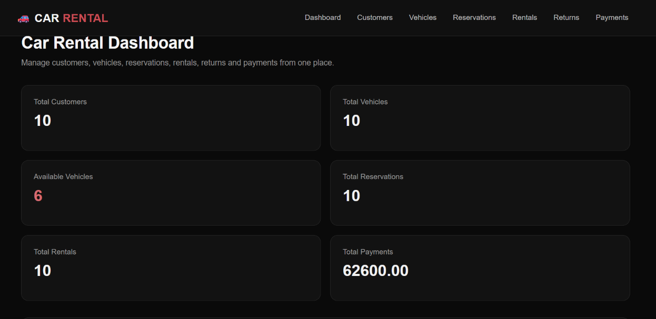
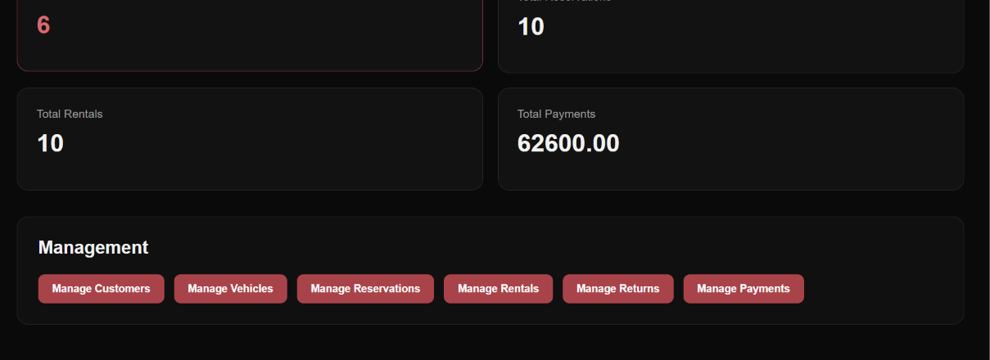
USER INTERFACE
05

Slide 6
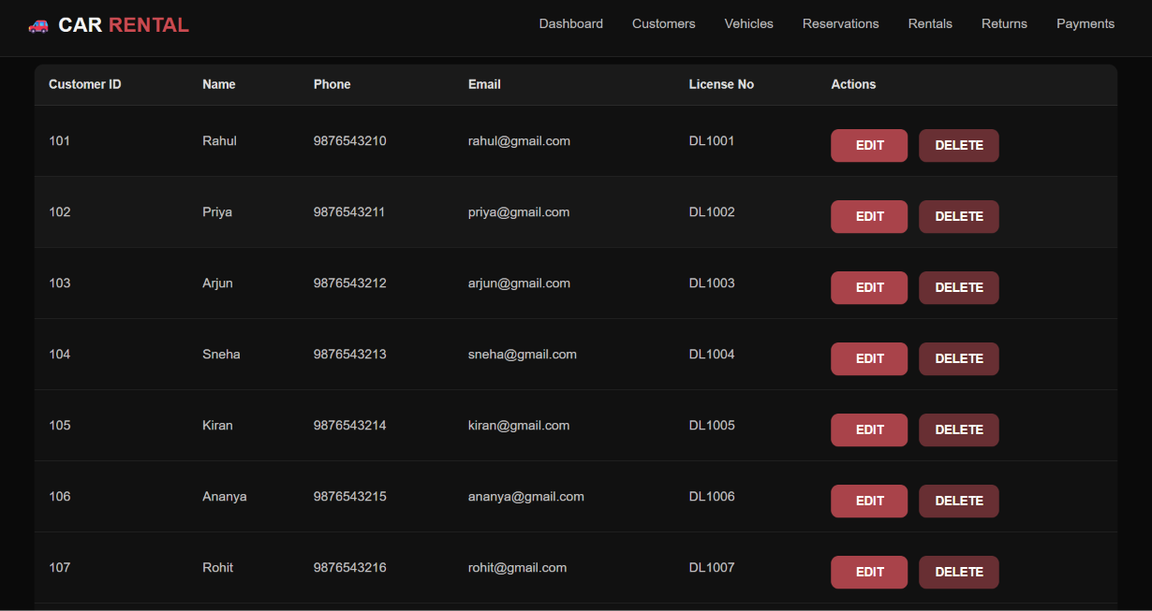
01. VIEW OPERATION
reallygreatsite.com
06

Slide 7
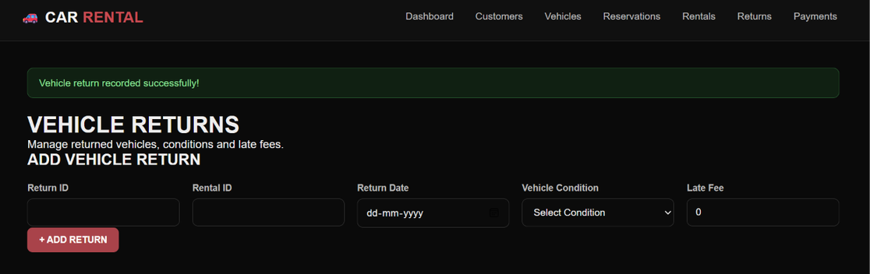
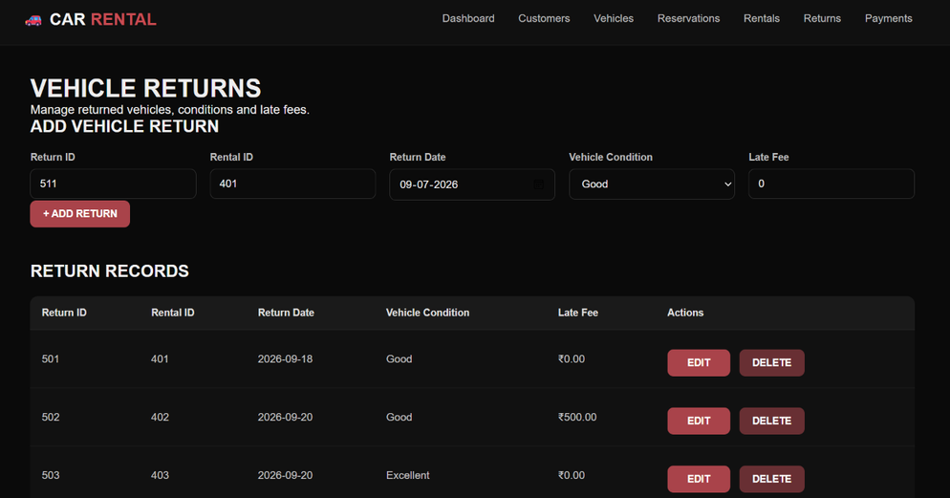
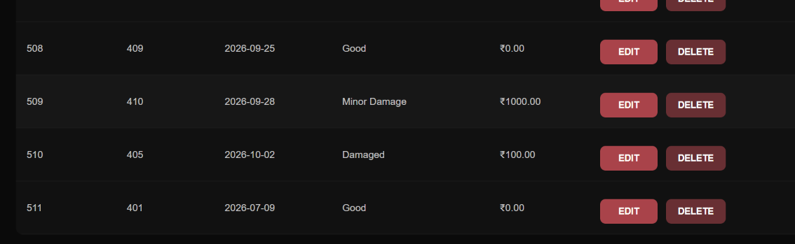
02.INSERTION OPERATION
reallygreatsite.com
07

Slide 8
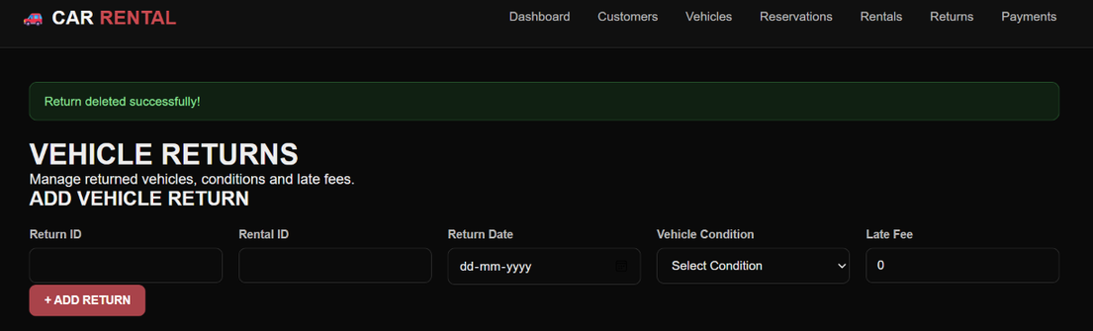
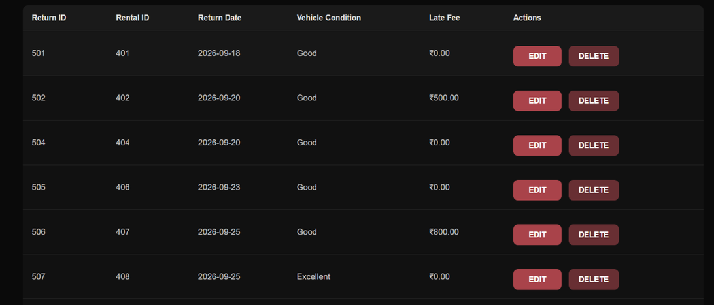
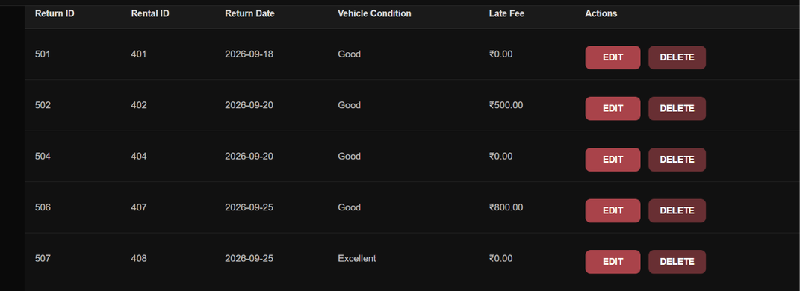
03. DELETION OPERATION
reallygreatsite.com
08

Slide 9
THANK YOU!
reallygreatsite.com
09

